Slide 1

Java 17 Feature

Slide 2
Introduction to Java Cadence Release
Java 17 is an LTS (Long Term Support) version just like Java 11
Even though Java 17 is the latest LTS release, this release is not much different from the previous ones. We again got a mixture of:
new language features (Sealed Classes),
API changes (InstantSource, HexFormat, context-specific deserialization filters),
a performance improvement (asynchronous logging of the JVM),
deprecations and deletions (Applet API, Security Manager, RMI Activation, AOT and JIT compiler),
and new preview and incubator features (Pattern Matching for switch, Foreign Function & Memory API, Vector API).

Slide 3
Important Features
1. Text Blocks
2. Switch Expressions
3. Records

Slide 4
Text Blocks
A lot of improvements have been made in order to make Java more readable and less verbose.
Example in eclipse

Slide 5
Switch Expressions
There are modifications in switch statement from Java 11 to Java 17.
Examples are in eclipse
Switch Expression can also return a value
Use of yield keyword

Slide 6
Records
Records will allow you to create immutable data classes
Currently, you need to e.g. create a class using the autogenerate functions of your IDE to generate constructor, getters, hashCode, equals and toString or you can use Lombok for this purpose. In the end, you end up with some boilerplate code or you end up with a dependency on Lombok in your project.
If we use the records class to create the above class, it will have same functionality and less verbose and will have less boiler plate code
Add limitation for record class
Example in the eclipse

Slide 7
Sealed Classes
Sealed Classes will give you more control about which classes may extend your class.
Sealed Classes is probably more a feature useful for library owners.
Sealed classes were first introduced in Java 15 as a preview feature. Three minor changes were published in Java 16.
With JDK Enhancement Proposal 409, Sealed Classes are declared ready for production in Java 17 without any further changes.

Slide 8
Pattern matching for instanceof
Example of Pattern matching is in eclipse

Slide 9
Helpful NullPointerExceptions
Helpful NullPointerExceptions will save you some valuable analyzing time. The following code results in a NullPointerException.

Slide 10
Compact Number Formatting Support
A factory method is added to NumberFormat in order to format numbers in compact, human-readable form according to the Unicode standard. The SHORT format style is shown in the code below:

Slide 11
Day Period Support Added
A new pattern B is added for formatting a DateTime which indicates a day period according to the Unicode standard.

Slide 12
Stream.toList()
In order to convert a Stream to a List, you need to call the collect method with Collectors.toList()

Slide 13
Foreign Function and Memory API
JDK 14 introduced the Foreign Function and Memory API as a preview feature, which was later finalized in JDK 16.
This API enables Java developers to access and call native functions and libraries written in other programming languages like C and C++. Additionally, it allows Java applications to allocate and manage native memory outside of the Java heap, which can be beneficial for performance-intensive tasks.
The Foreign Function and Memory API provides a simple and consistent way to interact with non-Java code and resources while maintaining the safety and security of the Java environment.
Add one example of this in eclipse code

Slide 14
Use of the Foreign Function and Memory API
Calling a C function from Java: Suppose you have a C function that you want to call from Java. With the Foreign Function and Memory API, you can define a Java interface that corresponds to the C function’s signature and call the function as if it were a Java method.
Using a C library from Java: Many popular libraries, such as OpenSSL and FFmpeg, are written in C or C++. With the Foreign Function and Memory API, you can load these libraries into your Java application and use their functions as if they were Java methods.
Allocating native memory: In some cases, you may need to allocate memory outside of the Java heap to improve performance. With the Foreign Function and Memory API, you can allocate and manage native memory directly from your Java code, using familiar Java syntax and semantics.

Slide 15
Default Classes for Java Ciphers
JDK 17 introduces new default classes for Java ciphers, which provide a simpler and more secure way to use cryptographic ciphers in Java applications.
The new default classes are designed to be easy to use and provide a high level of security by default, without requiring developers to be experts in cryptography.
The default classes include the AES cipher, which is widely used for symmetric encryption, and the ChaCha20 and XChaCha20 ciphers, which are modern stream ciphers that provide high speed and security.

Slide 16
Enhanced Pseudo-Random Number Generators
Until now, it was cumbersome to exchange the random number-generating classes Random and SplittableRandom in an application (or even to replace them by other algorithms)
Although they offer a mostly matching set of methods (e.g. nextInt(), nextDouble(), and stream-generating methods like ints() and longs()).
Through JDK Enhancement Proposal 356, Java 17 introduced a framework of interfaces inheriting from each other for the existing algorithms and new algorithms so that the concrete algorithms are easily interchangeable in the future
The methods common to all random number generators like nextInt() and nextDouble() are defined in RandomGenerator. So if you only need these methods, you should always use this interface in the future.
addition, duplicated code was eliminated from the existing classes, and code was extracted into non-public abstract classes
In the future, new random number generators can be added via the Service Provider Interface (SPI) and be instantiated via RandomGeneratorFactory..
The framework includes three new types of random number generators:
JumpableGenerator: provides methods to skip a large number of random numbers (e.g., 264).
LeapableGenerator: provides methods to skip a very large number of random numbers (e.g., 2128).
ArbitrarilyJumpableGenerator: offers additional methods to skip an arbitrary number of random numbers.

Slide 17
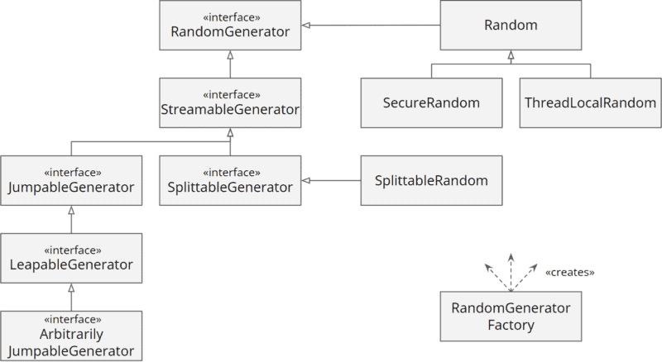
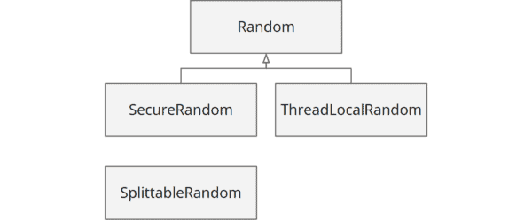
Old and New Class Hierarchy

Slide 18
Performance Improvements
Java 17 brings asynchronous logging, a long-overdue performance improvement to the Unified JVM logging system introduced in Java 9.

Slide 19
Preview and Incubator Features
Even though Java 17 is a long-term support (LTS) release, it contains preview and incubator features that are expected to reach production maturity in one of the next "intermediate releases". If you only use LTS releases, you have to wait at least until Java 23 to use these features.

Slide 20
Foreign Function & Memory API (Incubator)
Since Java 1.1, the Java Native Interface (JNI) offers the possibility to call native C code from Java. However, JNI is highly complex to implement and slow to execute.
To create a JNI replacement, Project Panama was launched. The concrete goals of this project are a) to simplify the implementation effort (90% of the work is to be eliminated) and b) to improve performance (by a factor of 4 to 5).
In the past three Java releases, two new APIs were introduced in the incubator stage:
The Foreign Memory Access API (introduced in Java 14, refined in Java 15 and Java 16),
The Foreign Linker API (introduced in Java 16).
JDK Enhancement Proposal 412 combined both APIs into the "Foreign Function & Memory API" in Java 17.

Slide 21
Vector API (Second Incubator)
As described in the article about Java 16, the Vector API is not about the old java.util.Vector class, but about mapping mathematical vector computations to modern CPU architectures with single instruction multiple data (SIMD) support.
JDK Enhancement Proposal 414 improved performance and extended the API, e.g., with support for the Character class (previously, Byte, Short, Integer, Long, Float, and Double were supported).

Slide 22
Deprecations and Deletions
Deprecate the Applet API for Removal
Java applets are no longer supported by any modern web browser and have already been marked as "deprecated" in Java 9.
JDK Enhancement Proposal 398 marks them as "deprecated for removal" in Java 17. This means that they will be completely removed in one of the next releases
Deprecate the Security Manager for Removal
The Security Manager has been part of the platform since Java 1.0 and was primarily intended to protect the computer and the user's data from downloaded Java applets. These were started in a sandbox, in which the Security Manager denied access to resources like the file system or the network.
Since Applet API is marked for removal, so this aspect of Security Manager will no longer be relevant.
For these reasons, the Security Manager was classified as "deprecated for removal" via JDK Enhancement Proposal 411 in Java 17.

Slide 23
Deprecations and Deletions(Continued)
Remove RMI Activation
Remote Method Invocation is a technology for invoking methods on "remote objects", i.e., objects on another JVM.
RMI Activation was marked as "deprecated" in Java 15 and wholly removed in Java 17 via JDK Enhancement Proposal 407.
Remove the Experimental AOT and JIT Compiler
In Java 9, Graal was added to the JDK as an experimental Ahead-of-Time (AOT) compiler. In Java 10, Graal was then made available as a Just-in-Time (JIT) compiler.
However, both features have been little used since then. As the maintenance overhead is significant, Graal was removed in the JDK 16 builds released by Oracle. Since no one complained about this, both AOT and JIT compilers were completely removed in Java 17 via JDK Enhancement Proposal 410.

Slide 24
Miscellaneous Changes in Java 17
New API for Accessing Large Icons
Add support for UserDefinedFileAttributeView on macOS
System Property for Native Character Encoding Name
Restore Always-Strict Floating-Point Semantics
New macOS Rendering Pipeline
macOS/AArch64 Port
New Page for "New API" and Improved "Deprecated" Page

